Slide 1
Welcome!
Please sign in.
Thank you!

Slide 2
Spring DEP Meeting
for Newly Certified Students
Differentiated Education Plan Meeting
March 15, 2016

Slide 3
Elon Park’s TD Team
Marie Deegan
mariea.deegan@cms.k12.nc.us
http://mariedeegan.weebly.com
Mary Slade
maryl.slade@cms.k12.nc.us
maryslade.weebly.com
Our TD Blog
http://tdeagleeye.weebly.com

Slide 4
Housekeeping Items
Tonight’s DEP Meeting presentation can be accessed via bitly link or QR code.
http://bit.ly/depspring16

Slide 5
Our Meeting Goals:
Explore how the needs of gifted and high-ability learners are met through the Catalyst Model.
Experience snapshots of gifted curriculum and resources and how we are integrating them into instruction at Elon Park.
Review the Differentiated Education Plan for 2nd graders.

Slide 6
TD Catalyst Teacher Responsibilities
Provide direct and indirect services to gifted and high-ability learners
Collaborate and plan with classroom teachers
Provide professional development on gifted strategies & best practices
Maintain compliance documents
Manage identification, testing & screening process for students

Slide 7
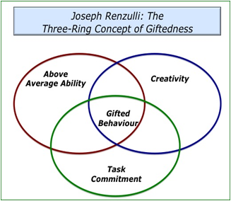
What is Giftedness?
• Outstanding levels of aptitude or competence
• An exceptional ability to reason and learn
• Top 10% or rarer
~ National Association for Gifted Children (NAGC)

Slide 8
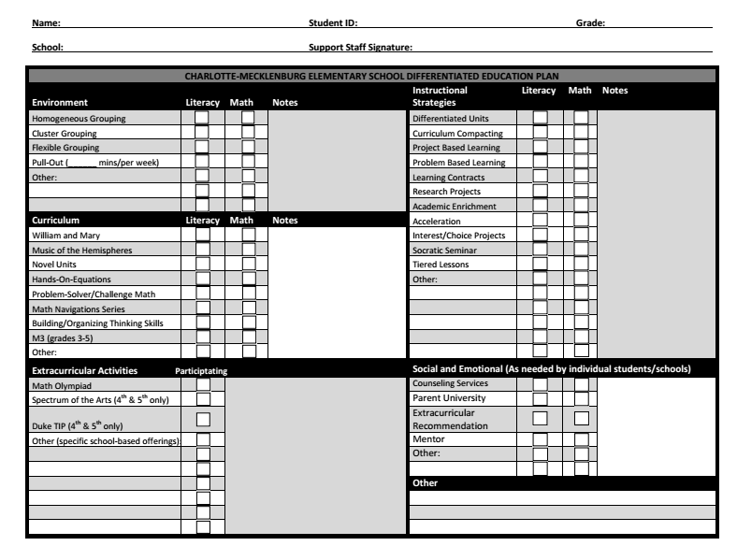
Differentiated Education Plan

Slide 9
Environment

Slide 10
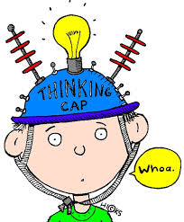
Our TD Program
Focus on quality not quantity
Quality of thinking, not more of the same
High expectations all day, every day
Complex, challenging & real world
Collaborative, integrated, and inclusive

Slide 11
Who are the Collaborators?
TD Catalyst Teachers
Classroom Teachers
Administrators
Academic Facilitators
Parents & Community Members

Slide 12
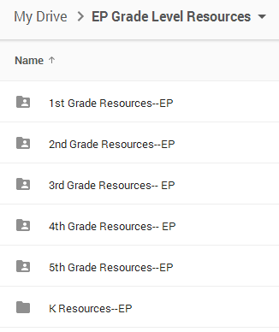
How Does Collaboration Occur?
blended approach-- combination of face-to-face and technology
weekly scheduled grade level planning meetings
Email
use of Google Drive
participation in long-term planning sessions
after-school planning sessions, as needed

Slide 13
The Catalyst Model is responsive to the notion that...
Gifted education is NOT an add-on for 90 minutes a week because gifted learners are gifted all the time.

Slide 14
Catalyst Model
Joint effort by TD Catalyst Teachers and Classroom Teachers
Allows classroom and TD teacher to design & implement frequent differentiated educational experiences for gifted and high-ability students
Co-teaching whole group mini-lessons, small group lessons, individual conferring
Modeling of higher level strategies

Slide 15
TD Catalyst Model @ Elon Park
Classroom teachers AND Dr. Slade & Ms. Deegan share responsibility for the education of gifted & high-ability learners.
TD teachers work closely with classroom teachers to…
collaborate and plan higher level, accelerated learning experiences
teach and co-teach lessons in math and literacy
provide tailored small group and individualized instruction to students

Slide 16
Benefits of Catalyst Model
More students are served more often.
Gifted education and general education are related, connected, and integrated.
The pace of learning is enhanced.
High achieving students receive more challenging tasks within the classroom.
Classroom and TD Teachers work together to maximize student learning.

Slide 17
Our Learning Environment
Flexible grouping within classroom
High expectations
Multiple methods of instruction-- whole group, small group, individual
Technology access (SMART boards, Chromebooks, iPads, BYOT, etc..)
Enriched, rigorous, academically challenging instruction

Slide 18
Who Does My Child Work With?
Dr. Slade
2nd Grade: Mullen, Mooney
3rd Grade: Asseff, Gilbert, Long
4th Grade: N. Deegan, Murrer
5th Grade: J. Butler, Sternberg
Mrs. Deegan
2nd Grade: Thomas, Allison, Young, Cusimano, Joyner, Strawderman
3rd Grade: Little, Patience
4th Grade: Franczak, Stennie, Donovan, Weaver, Bost
5th Grade: Kiser, Deer, M. Butler, Herbes, Shenoha
*TD Flex Time to provide another layer of differentiation

Slide 19
Curriculum

Slide 20
Our Curriculum
Differentiated Instruction
Interest/Choice Projects
Learning Contracts
Tailored small group instruction
Curriculum compacting
Greater depth and complexity
Enrichment
Subject integration
Standard curriculum supplemented with research-based gifted resources & strategies
William & Mary Language Arts Units
Jacob’s Ladder
Project M3 Math
Problem Solver

Slide 21
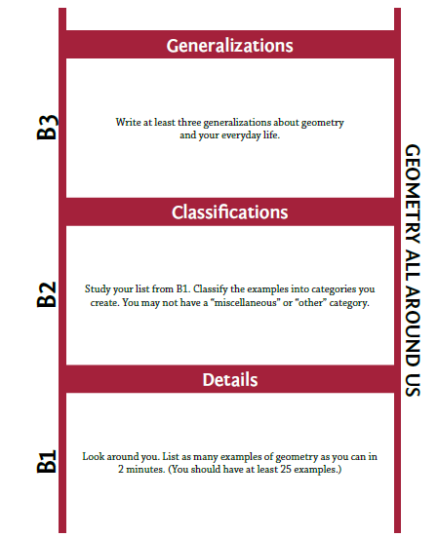
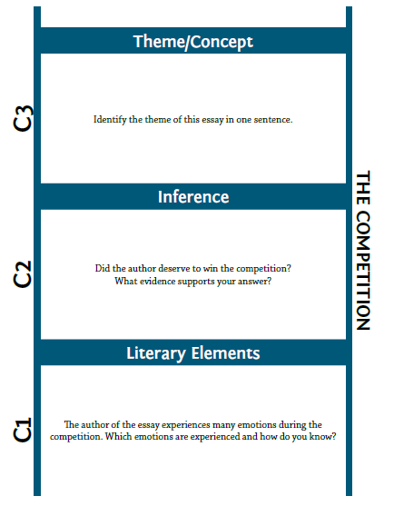
Snapshots of TD Curriculum
Jacob’s Ladder
Reading Comprehension Program
Project M3 Math

Slide 22
Snapshots of TD Curriculum
Concept Development (Cycles)
(William & Mary Language Arts Teaching Model)
Hands On Equations

Slide 23
Snapshots of TD Curriculum
Beyond Base Ten
Caesar’s English

Slide 24
Instructional Strategies

Slide 25
What Types of Strategies are Used?
Problem-Based Learning
Paideia Seminars
Learning Contracts
Interest/Choice Boards
Integrated Projects
Tiered Lessons
Curriculum Compacting
Independent Studies when appropriate

Slide 26
Thank you for partnering with us!
Here is a resource to help challenge your readers at home:
http://bit.ly/readingquestionstems

